Slide 1
Genome Rearrangement Visualization
Interactive visualization for high dimensional data
-Sruthi Chappidi
-Rashika Mishra

Slide 2
Problem Statement
Coming up with a novel approach for Genome Visualization for easy identification and understanding.
Features of the proposed techniques :
Visualization of Genome rearrangement with DCJ(Double-Cut-Join) operation.
The visualization approach should have provision to display the different operations in a DCJ cut.
The new approach should also display the adjacency graph.
Notes:
A DCJ operation on a genome G cuts two different adjacencies in G and glues pairs of the four exposed extremities to form two new adjacencies.
unifies all the classical operations. ( INVERSION, TRANSLOCATION AND FISSION)
local operation on four vertices, initially connected in pairs. It consists
of cutting two connections (breakpoints) in the first genome, and
rejoining the resulting four unconnected vertices in two new pairs,
the transformation
of ‘initial’ genome A to ‘target’ genome B by a minimal number of
DCJ operations.

Slide 3
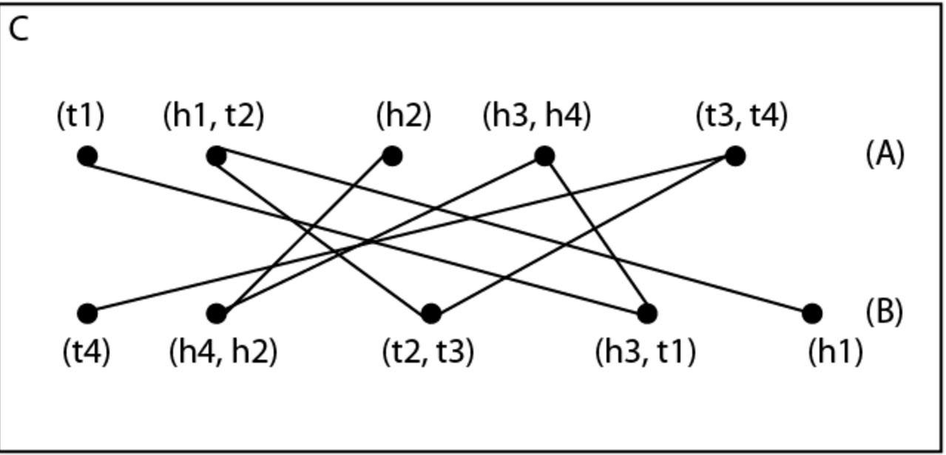
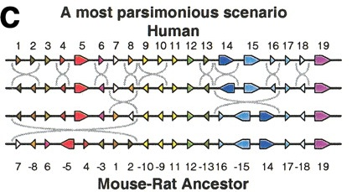
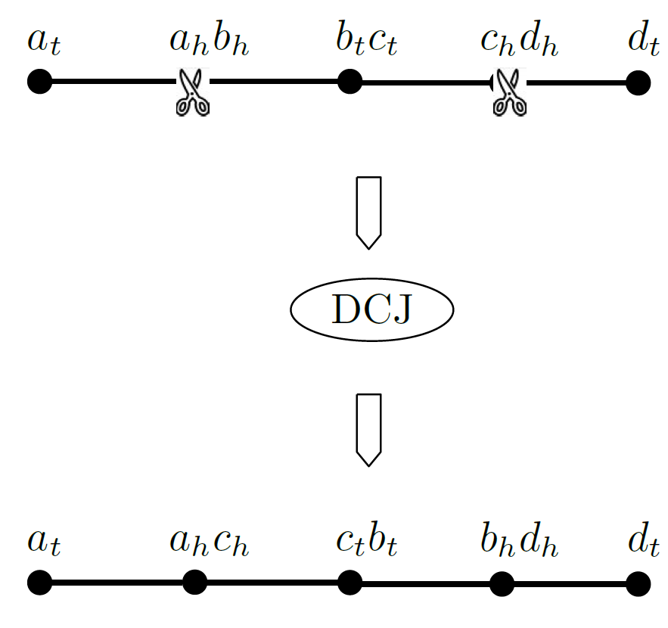
Background
Genome rearrangement is the process of transforming one genome into another genome with various operations that are widely known such as inversions, translocations, fusion, and fission.
Adjacency graph provides visual picture of genomes showing the relation between various genes
A DCJ operation on a genome G cuts two different vertices in G and joins pairs of the four exposed extremities to form two new adjacencies.
Notes:
is a bidirected graph in which the vertices represent segments of DNA and the edges represent adjacency between segments in a genome.
each edge connects the tail end of one segment with the head end of another segment.
adjacency edge is labelled by a (possibly empty) string of DNA

Slide 4
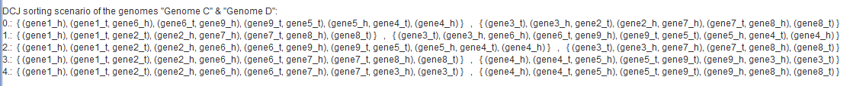
CHALLENGES
Adaptability to larger genomes and interactive display of intermediate steps
Time consuming
Complexity increases with size of genome
The goal is to automate the visualization and show intermediate steps leading to complete rearrangement.

Slide 5
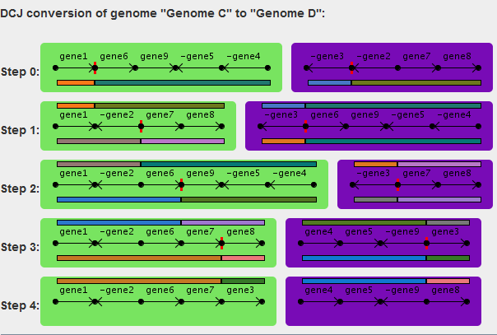
Existing Visualization Techniques
Advantages:
Automated
Disadvantage:
Adaptability
Adjacency graph not displayed
Performed operation not clear

Slide 6
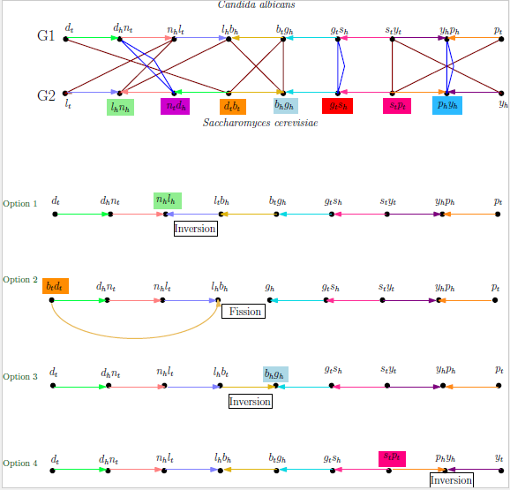
Existing Visualization Techniques Cont’d
Advantages:
Display of Adjacency graph
Annotated operations
Disadvantage:
Adaptability
Manual process

Slide 7
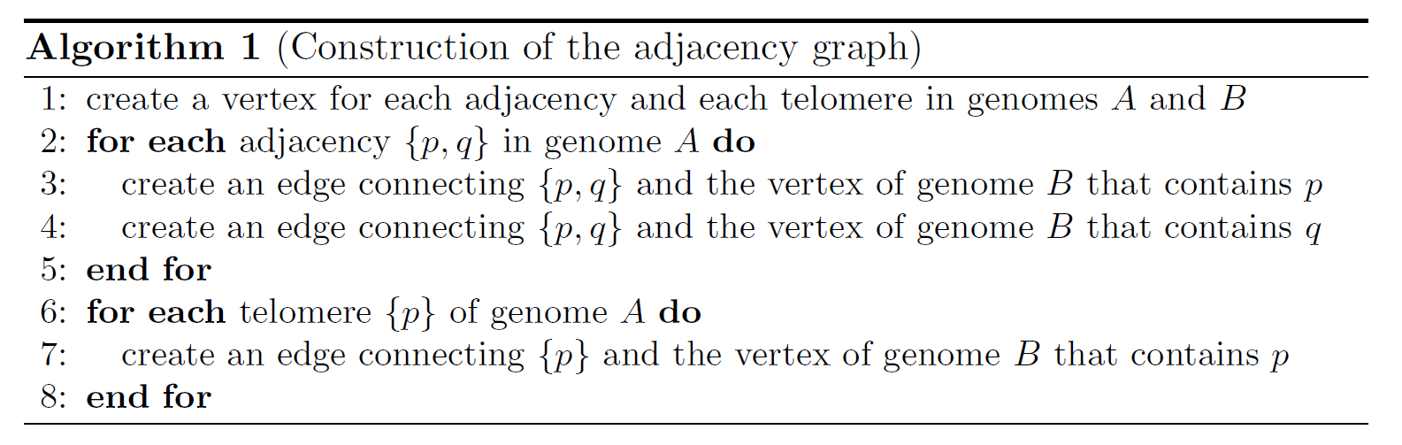
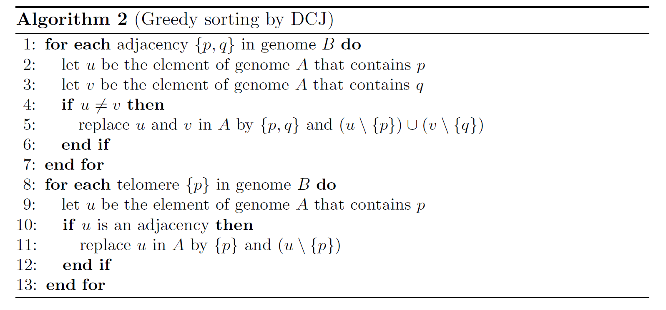
Algorithm

Slide 8
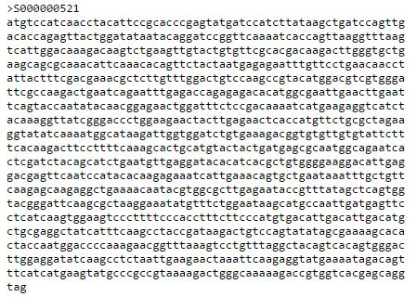
DATA
The data is stored as .Fasta files.
Multi-FASTA format is a text-based format for representing either nucleotide sequences or peptide sequences, in which base pairs or amino acids are represented using single-letter codes.
Java code to read the fasta file and save as a color map.

Slide 9
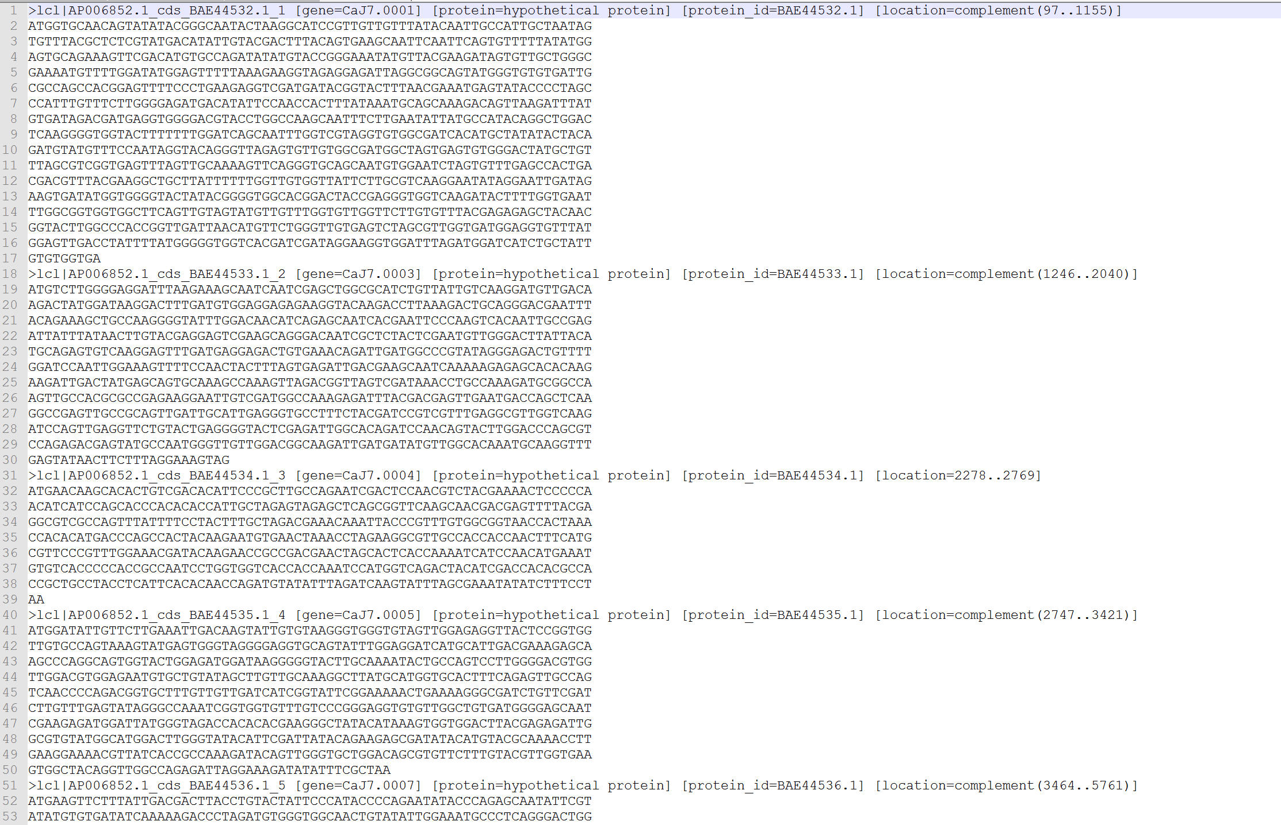
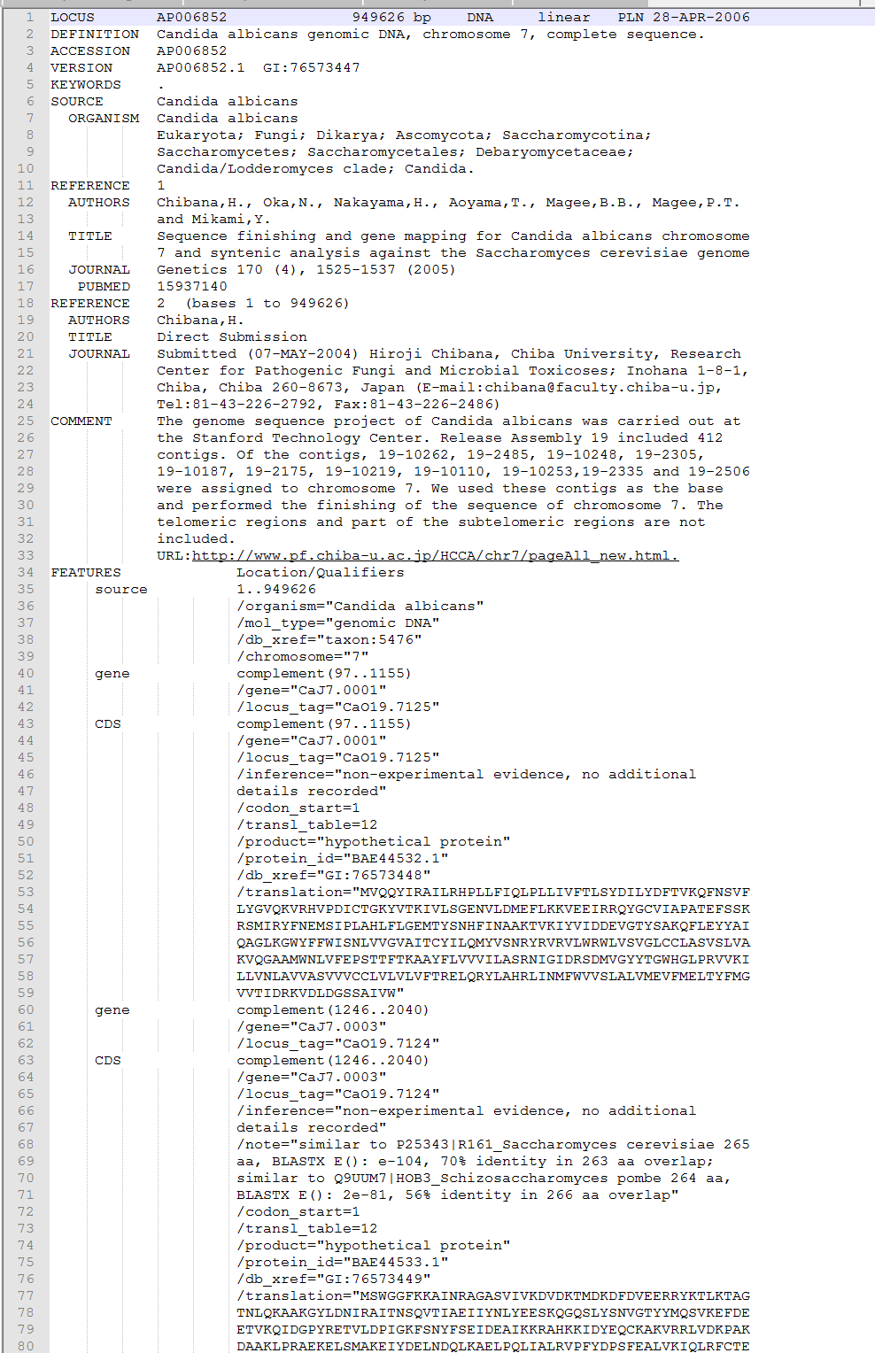
Challenges
Input Data Format needed to be changed
Multi-Fasta
GenBank file

Slide 10
Challenges Continued
>lcl|AP006852.1_cds_BAE44532.1_1 [gene=CaJ7.0001] [protein=hypothetical protein] [protein_id=BAE44532.1] [location=complement(97..1155)]
The location and gene position not consecutive in both sets of data

Slide 11
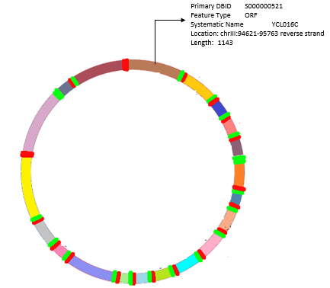
OUR APPROACH
Circular Color Map
Each gene is represented by a different color
Head and Tail are coded as Red and Green colors respectively to represent the orientations.
Non circular genes are visualized with black arc
Each gene will have a pop up description.
http://www.genomecompiler.com/plasmid-viewer/

Slide 12
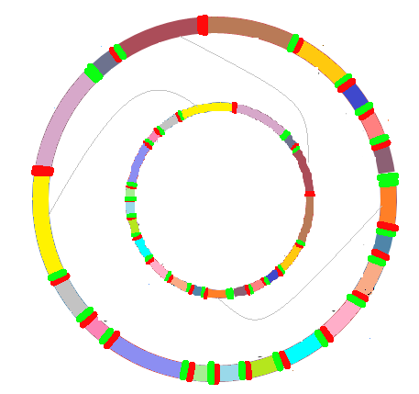
OUR APPROACH CONTD.
Adjacency graph links are depicted with the same color in the source and target genome.
User interaction to start the DCJ operation.
User can select the lightly colored links.
https://bost.ocks.org/mike/hive/

Slide 13

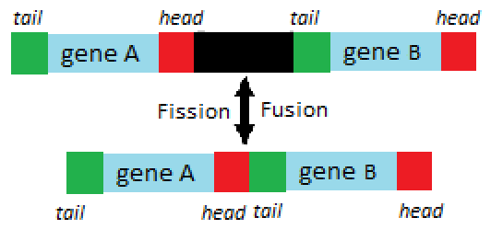
OUR APPROACH CONTD.
The different operations are shown as
Inversion
Fission and Fusion

Slide 14
References
By ProboscideaRubber15 (Own work) [CC BY-SA 4.0 (http://creativecommons.org/licenses/by-sa/4.0)], via Wikimedia Commons
Reconstructing the Genomic Architecture of Ancestral Mammals: Lessons From Human, Mouse, and Rat Genomes Guillaume Bourque, Pavel A. Pevzner and Glenn Tesler (2004)
Bergeron, A. and Mixtacki, J. and Stoye, J. Chapter 10: The inversion distance problem., , 2005
Chappidi, S. and Bereg, S. (2016). Visualization of genome rearrangement using DCJ operations., 2016

Slide 15
Questions?

